Slide 1
Cartoonification using CycleGANs
Group members :
Suprava Sahoo (st120984)
Shrabin Tuladhar (st121718)
Urusha Rajkarnikar (st121263)

Slide 2
Outline
Introduction
Related Work
Objective
CycleGAN
Implementation
Experiment & Results
Research Challenges and Future scopes
Conclusion

Slide 3
1.
INTRODUCTION

Slide 4
Introduction
Many problems in image processing, computer graphics, and computer vision can be posed as “translating” an input image into a corresponding output image. Eg: a picture maybe rendered as an RGB image, black and white etc.
Cartoonification means transforming a human faces into a certain cartoon-like character.

Slide 5
Introduction (Contd.)
These type of transformations are quite popular.
In this paper, we aim at generating alike cartoon faces for any person automatically.
We cast this problem as an image-to-image translation task. However, we consider unpaired training data between cartoon and real faces.

Slide 6
Introduction (Contd.)
Image-to-image translation was first introduced by Isola et al , which utilizes the generative adversarial network (GAN) to translate an image from a source domain to a target domain such that the translated images are close to the ground truth measured by a discriminator network.
This method and the follow-up works require paired data for training.

Slide 7
Introduction (Contd.)
However, it is not always easy to obtain a large amount of paired data. Thus, CycleGAN was introduced.
It uses the cycle consistency loss to train two pairs of generators and discriminators in order to regularize the solution of trained networks.

Slide 8
2.
RELATED WORK

Slide 9
Related Work
In the image generation problem is tackled using autoregressive models, restricted Boltzmann machines , and autoencoders.
Recently, generative techniques are proposed for image translation tasks.
Models such as GANs and VAEs achieve impressive results in image generation.
They are also utilized in conditional settings to address the image-to-image translation problem.
Prior research shows relatively less attention given to unsupervised setting.
Many state-of-the-art unsupervised image-to-image translation frameworks are developed based on the cycle-consistency constraint.

Slide 10
Related Work (Contd.)
However, they have not considered any mechanisms to force their auxiliary latent variables to represent only the domain-specific information.
Unpaired image-to-image translation frameworks (Zhu et al., 2017; Liu et al., 2017; Shrivastava et al., 2017; Kim et al., 2017) such as CycleGAN remove the requirement of having detailed pixel level supervision.
In CycleGAN this is achieved by enforcing a bi-directional prediction from source to target and target back to source, with an adversarial penalty in the translated images in the target domain.

Slide 11
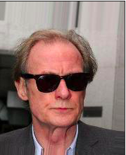

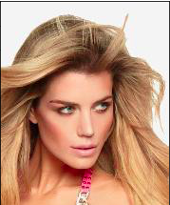
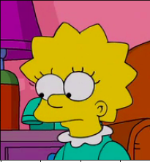
3. OBJECTIVES
To transform a person’s face into cartoon-like character.
To learn how Cycle GAN functions and how it is different from other GANS.

Slide 12
Why CycleGAN?
CycleGAN is a technique that involves the automatic training of image - to - image translation models without paired examples.
Image - to - image is a class of vision and graphics problem where the goal is to learn the mapping between an input image and output image.
It can be applied as style transfer,season transfer and photo enhancement.

Slide 13
4.
CYCLE GAN

Slide 14
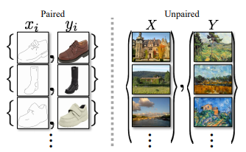
4.1 Overview
CycleGAN is an approach to training image-to-image translation models using the generative adversarial network, or GAN model architecture.
The CycleGAN is an extension of the GAN architecture that involves the simultaneous training of two generator models and two discriminator models.
In CycleGAN we treat the problem as an image reconstruction problem.

Slide 15
4.1 Overview (Contd.)
We first take an image input (x) and use the generator G to convert into the reconstructed image. Then we reverse this process from reconstructed image to original image using a generator F. Then we calculate the mean squared error loss between real and reconstructed image.
The most important feature of this CycleGAN is that it can do this image translation on an unpaired image where there is no relation exists between the input image and output image.

Slide 16

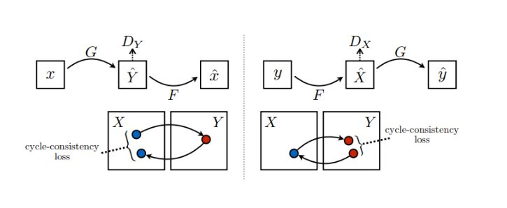
4.2 Architecture of Cycle GAN
In Cycle GAN model, Model G is trained to translate images from domain X to domain Y, much like Pix2Pix, but additionally it also trains a model F that translates images in the opposite direction - from domain Y to domain X. This introduces a cycle, hence the name, Cycle GAN.
where X is the input image distribution and Y is the desired output distribution.

Slide 17
4.3 Defining Models
CycleGAN comprises of:
2 Discriminators (D_x , D_y)
2 Generators (G_xtoy , G_ytox)
2 Additional losses
Forward cycle consistency loss : x → G(x) → F(G(x)) ≈ x
Backward cycle consistency loss : y → F(y) → G(F(y)) ≈ y

Slide 18


4.3 Defining Models (Contd.)
Objective consists of:
Adversarial loss:
Cycle Consistency loss:

Slide 19
4.3.1 Generator Architecture
Each CycleGAN generator has three sections:
Encoder
Transformer
Decoder
The input image is passed into the encoder. The encoder extracts features from the input image by using Convolutions and compressed the representation of image but increase the number of channels. The encoder consists of 3 convolution that reduces the representation by 1/4 th of actual image size.

Slide 20
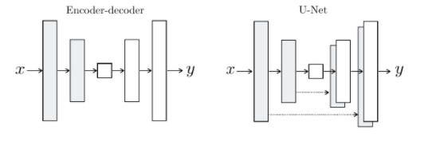
4.3.1 Generator Architecture
(Contd.)
Then the output of encoder after activation function is applied is passed into the transformer. The transformer contains 6 or 9 residual blocks based on the size of input. The output of transformer is then passed into the decoder which uses 2 -deconvolution block of fraction strides to increase the size of representation to original size.

Slide 21
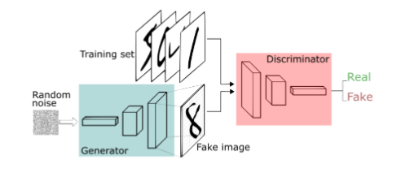
4.3.2 Discriminator Architecture
The discriminator would take an image as an input and try to predict if it is an original or the output from the generator. Generator can be visualized in the following image.

Slide 22
5.
IMPLEMENTATION

Slide 23
Implementation
We adopt the architecture for our common latent encoder, generator, and discriminator networks from Zhu and Park et al. .
The domain-invariant encoders includes two stride-2 convolutions, and three residual blocks.

Slide 24
Implementation (Contd.)
The generators consist of three residual blocks and two transposed convolutions with stride-2. The domain-specific encoders share the first two convolution layers with their corresponding domain-invariant encoders, followed by five stride-2 convolutions.

Slide 25
Implementation (Contd.)
Since the spatial size of the domain-specific codes do not match with their corresponding domain-invariant codes, we made them to be the same size as the domain-invariant codes, and then concatenate them to create the generators’ inputs.
For the discriminator networks we use 200 × 200 CycleGAN networks, which classifies whether 200 × 200 overlapping image patches are real or fake. We use Adam optimizer for online optimization with the learning rate of 0.0002.

Slide 26
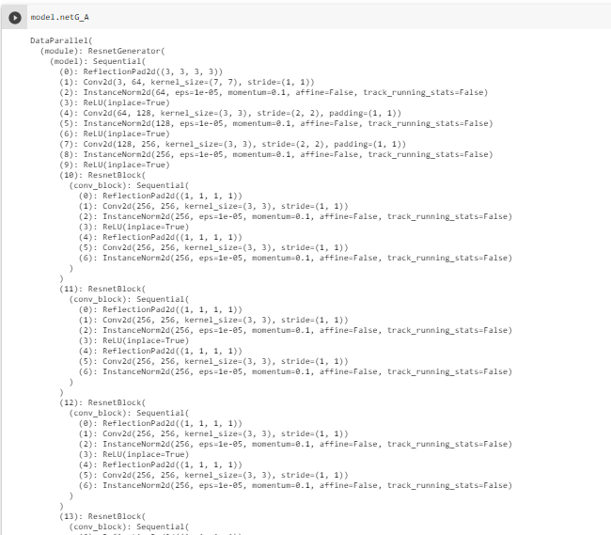

Slide 27
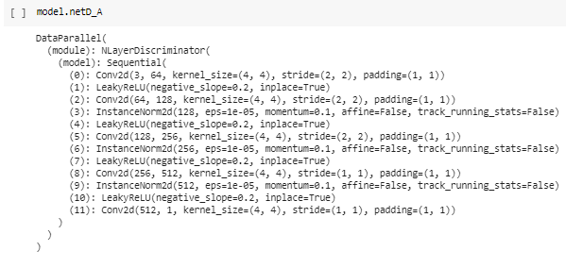

Slide 28
5.
EXPERIMENTATION
&
RESULTS

Slide 29
Experimentation & Results
At first we had no idea which GAN to actually use for our project, so experimented with Style GAN, however, we found it was not exactly what we were looking for, so we decided to go with Cycle GAN after consulting Prof. Matthew Dailey.
As we decided to use Cycle GAN for our project we could experiment with the inverse of what our objective actually was.
We were able to achieve the results as shown below in 10 epochs.

Slide 30
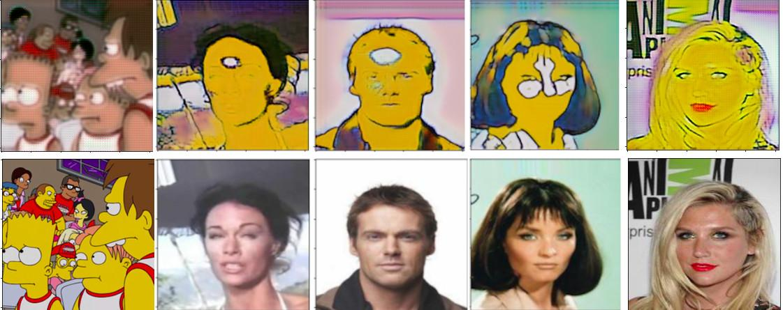
These results show the progress of the model(epochs 2,4,6,8).

Slide 31
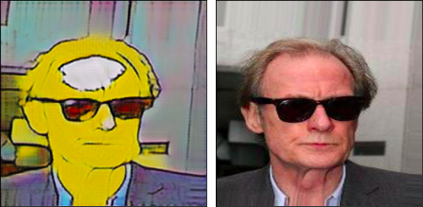
At the end of 10th epoch our results looked something like this

Slide 32
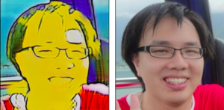
Which we found was pretty good, so we tested Prof Chaklam’s photo from his facebook

Slide 33
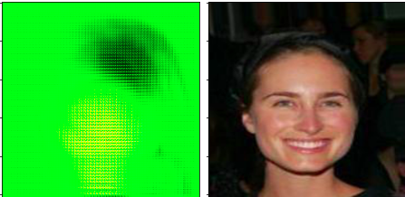
The results of epoch 12 were very disappointing as the image started to turn green and we learned the hard way that Mark Twain’s story may actually be true.

Slide 34
5.
RESEARCH CHALLENGES & FUTURE WORK

Slide 35
Research Challenges & Future Work
Firstly, we had a bit of difficulty in deciding which type of GANs is best for our project between the Cycle GAN and Pix2pix CGAN.
Secondly, due to the geometric inconsistency issue between the two domains, there was some extent of distortion seen in the final generated image.
Lastly, we also had trouble managing the dataset for Simpson faces as well for the human faces.
For future works we plan to resolve the issue of distortions in the final generated image thereby, producing even high quality images.

Slide 36
5.
CONCLUSION

Slide 37
Conclusion
Cycle GAN has the ability to generate very good results for unpaired and paired data.
In this paper, we presented a general framework for unsupervised image-to-image translation.
We showed that it learned to translate an image from one domain to another without any corresponding images in two domains in the training dataset.
In particular, we observe that the improvement in performance increases as the dataset size decreases.

Slide 38
Conclusion (Contd.)
As image-to-image translations models require a large amount of data, learning from unlabelled examples is of paramount importance. It is also interesting how learning the inverse mapping can be used to allow the model to learn on unpaired datasets.
However, there are some limitations in this such as not getting very pronounced output images as hoped.
We hope that the proposed approach gives rise to further research work.

Slide 39


